Slide 1
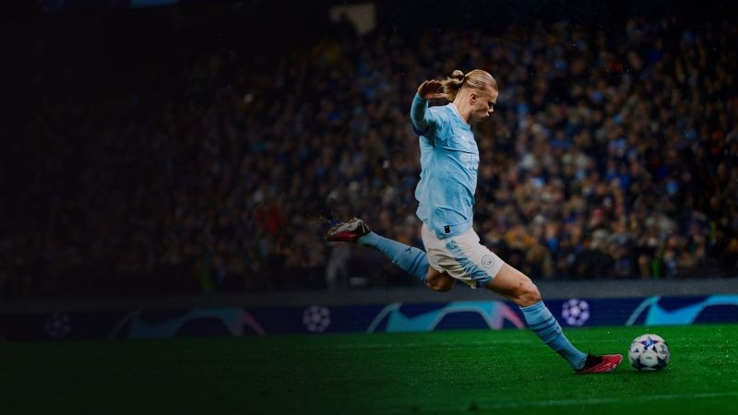

e
CHELSEA TRANSFER ANALYSIS
TEAM: BORA’s EXPLORAS

Slide 2



STEPS followed:
CHELSEA ‘24
Introduction
Clean and Process Data
Explore the Data
Transfer Strategy
Data Visualisation
Finalise Team & Budget
Conclusion
40.9%
10th
Winning percent
Rank in league
$ 1 BN+
Money spent

Slide 3

STEPS followed:
PRE-PROCESSING
Introduction
Clean and Process Data
Explore the Data
Transfer Strategy
Data Visualisation
Finalise Team & Budget
Conclusion
Fetch data from understat API for different leagues
Combine relevant data
Fix header formats and issues
Remove columns and attributes of no use
Ensure no missing values
Calculated field from other data tables and included in main dataset

Slide 4
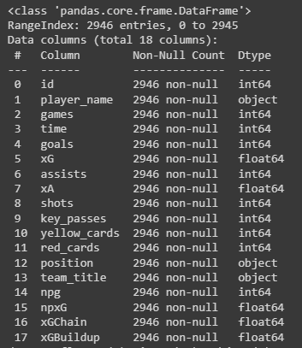
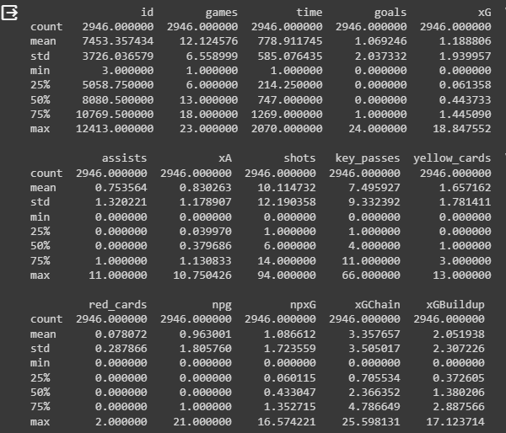
STEPS followed:
Explore the data
Introduction
Clean and Process Data
Explore the Data
Transfer Strategy
Data Visualisation
Finalise Team & Budget
Conclusion
Figured out variables we would need for statistics
df.info()
df.describe()

Slide 5
TRANSFER STRATEGY
STEPS followed:
Chelsea vs Table Toppers Comparision
Chelsea – Past vs Present Comparision
Identify Chelsea’s Weakness
Comparison of Chelsea’s Players vs Other team’s players
Comparison of Chelsea’s Players within themselves
Decide Players to SELL
Optimise best players wrt budget
Decide Players to BUY
Introduction
Clean and Process Data
Explore the Data
Transfer Strategy
Data Visualisation
Finalise Team & Budget
Conclusion

Slide 6

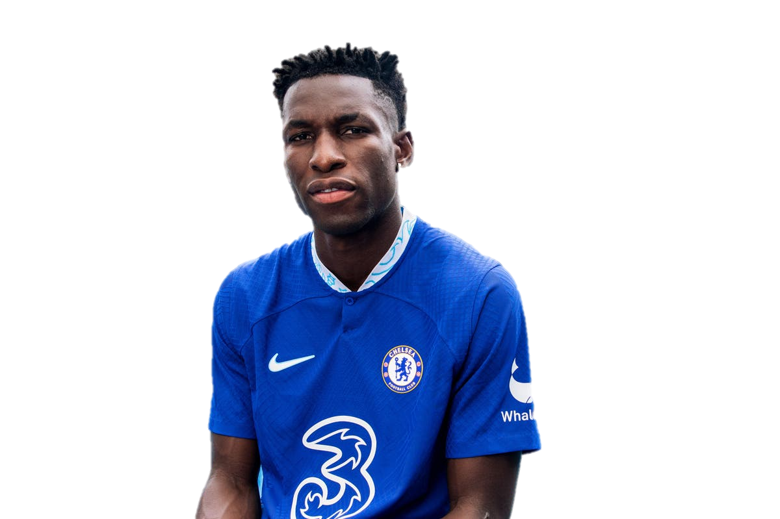
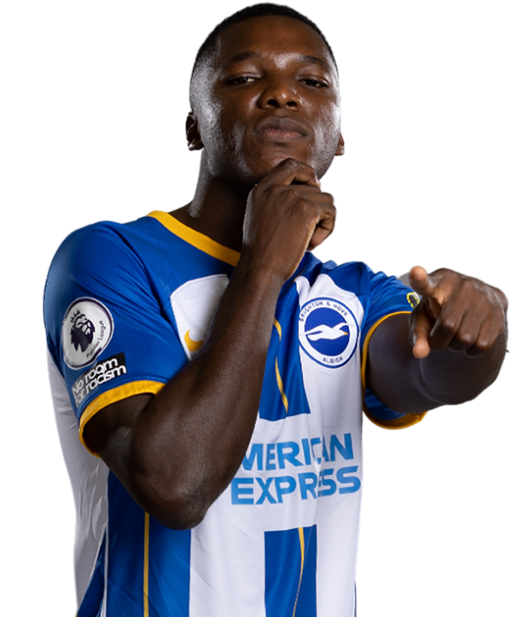
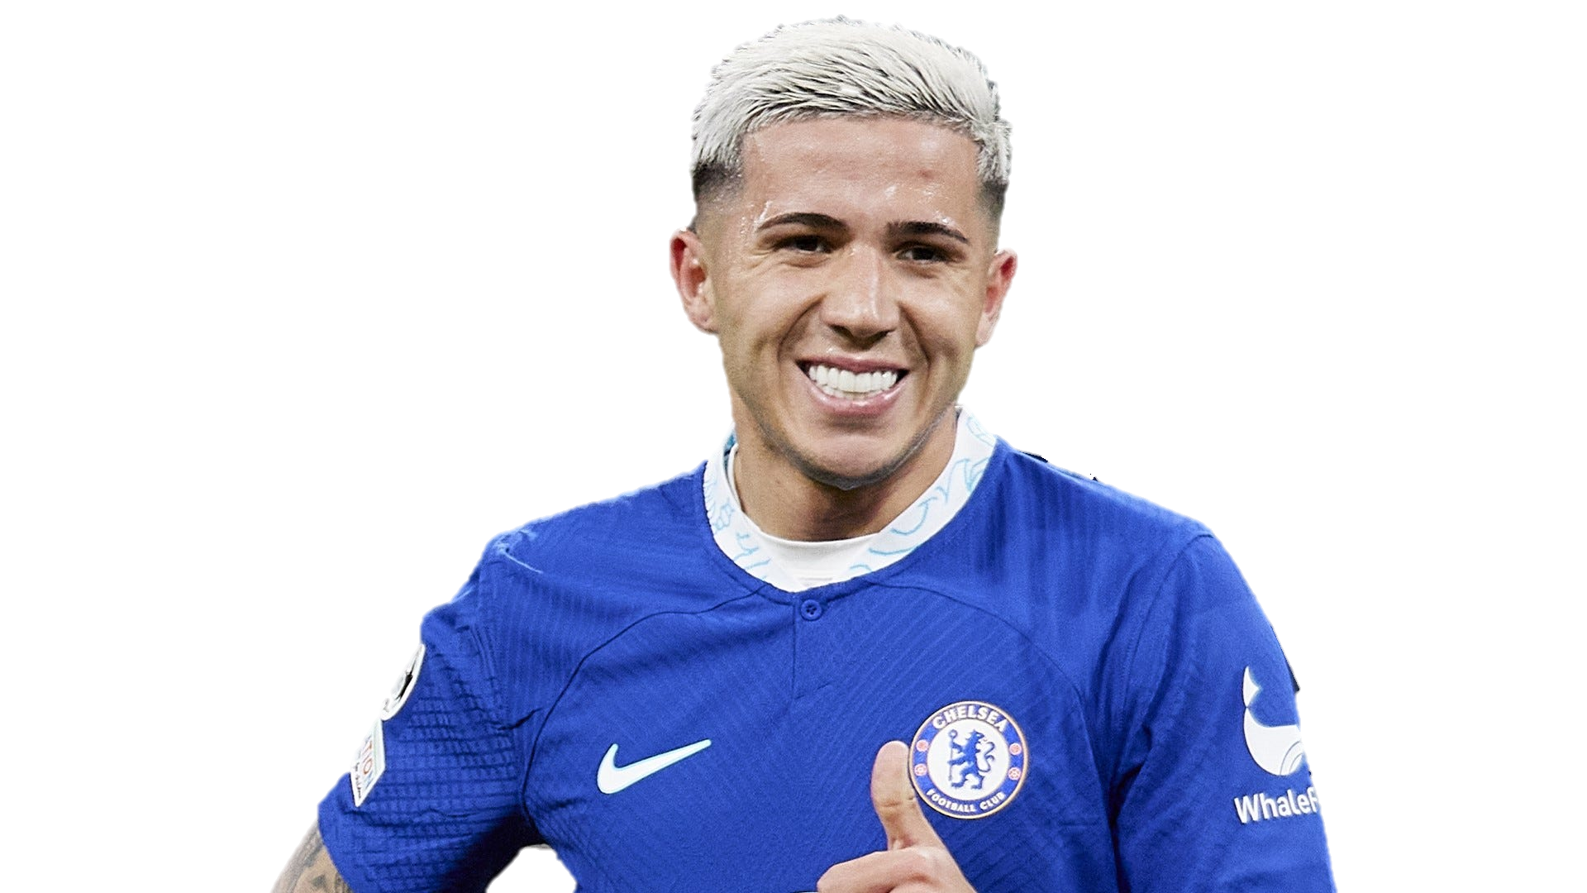
Nicolas Jackson
Enzo Fernández
Moisés Caicedo
G
7
XG
11.2
Shots
45
A
2
XA
2.1
Key Passes
17
A
0
XA
0.8
Key Passes
10
SOLD
INJURED

Slide 7
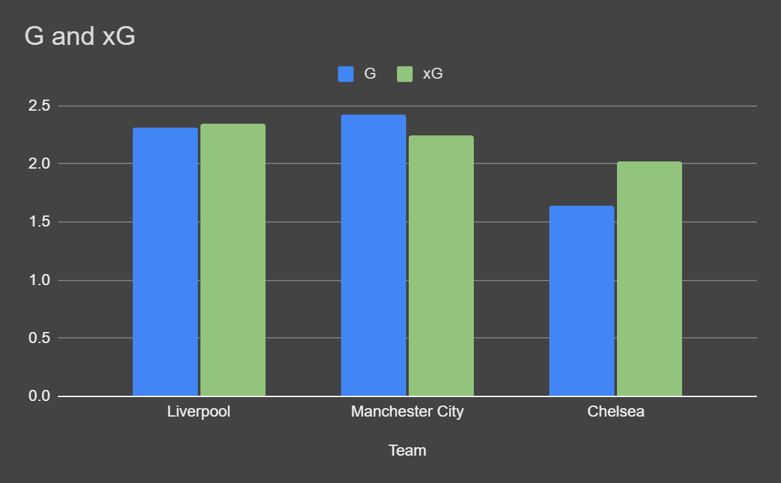
STEPS followed:
DATA VISUALISATION
Introduction
Clean and Process Data
Explore the Data
Transfer Strategy
Data Visualisation
Finalise Team & Budget
Conclusion

Slide 8
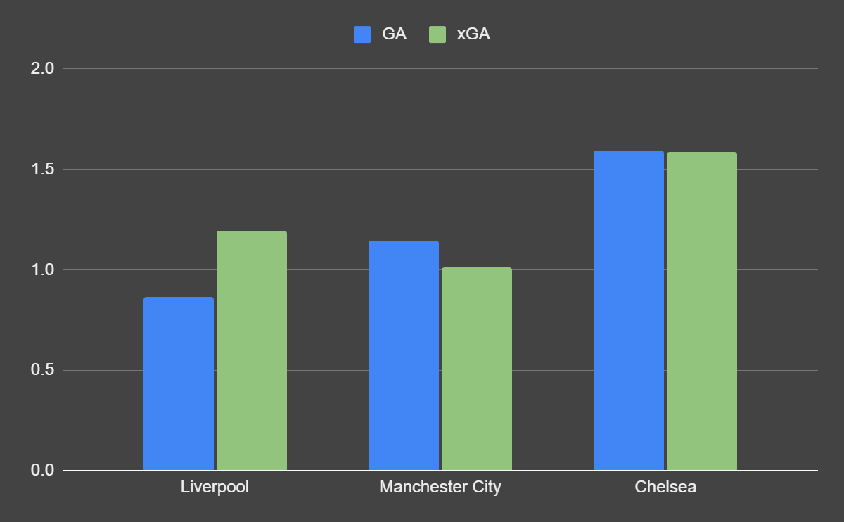

Slide 10
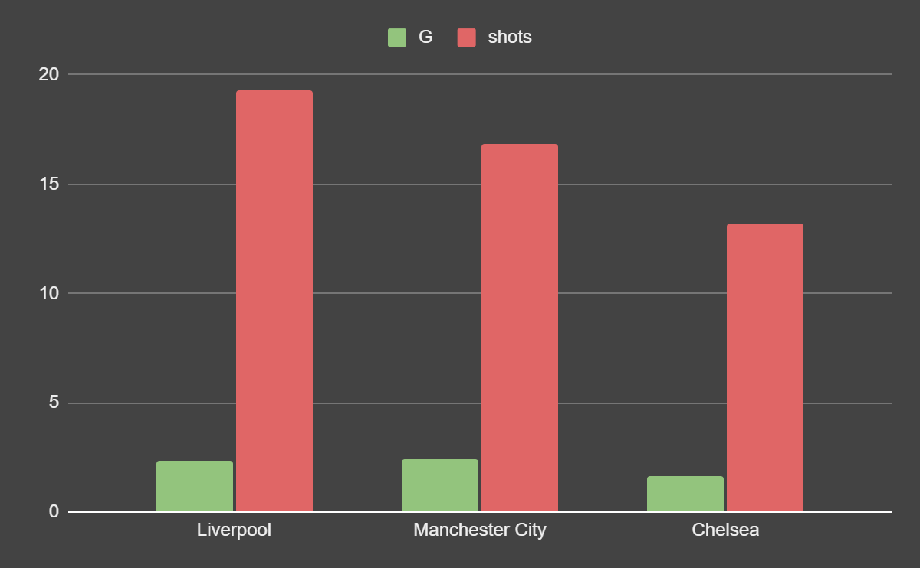

Slide 12
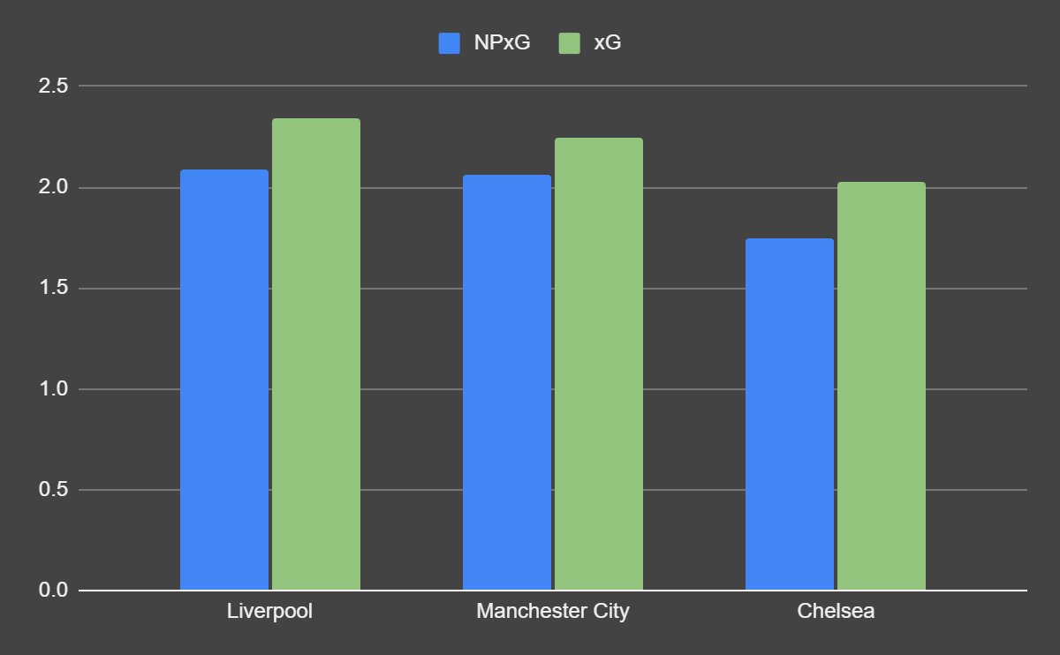

Slide 13
An attacker outperforming their XG is needed.
GA and xGA extremely high in comparison. Defense upgrade massively needed. A major shot stopper or blocker, a GK or a DEF.
Lesser Shots taken by the team. Creative mid with more key passes required.
NPXg<<Xg. This means penalties are getting converted and a penalty specialist is not a necessity

Slide 14
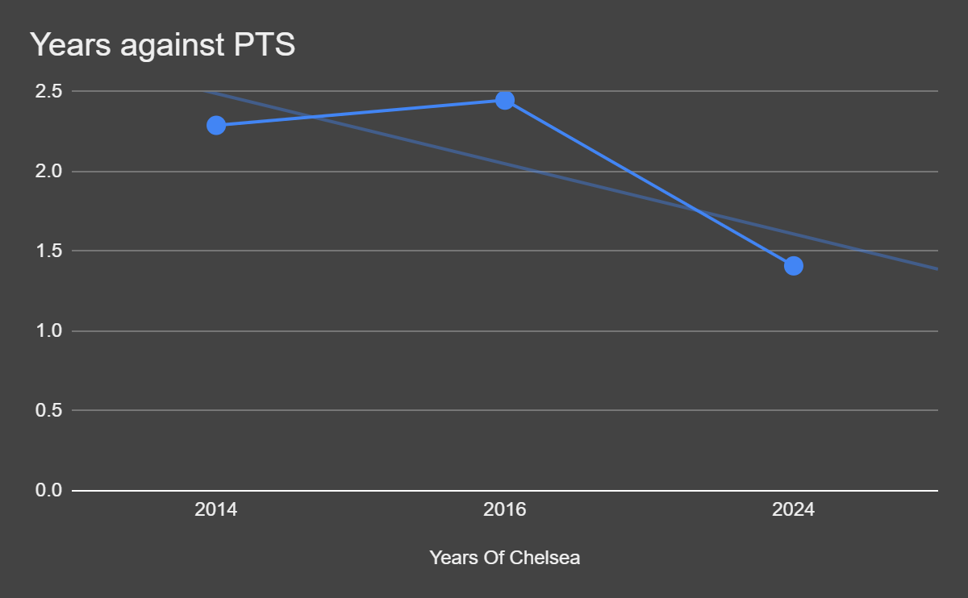
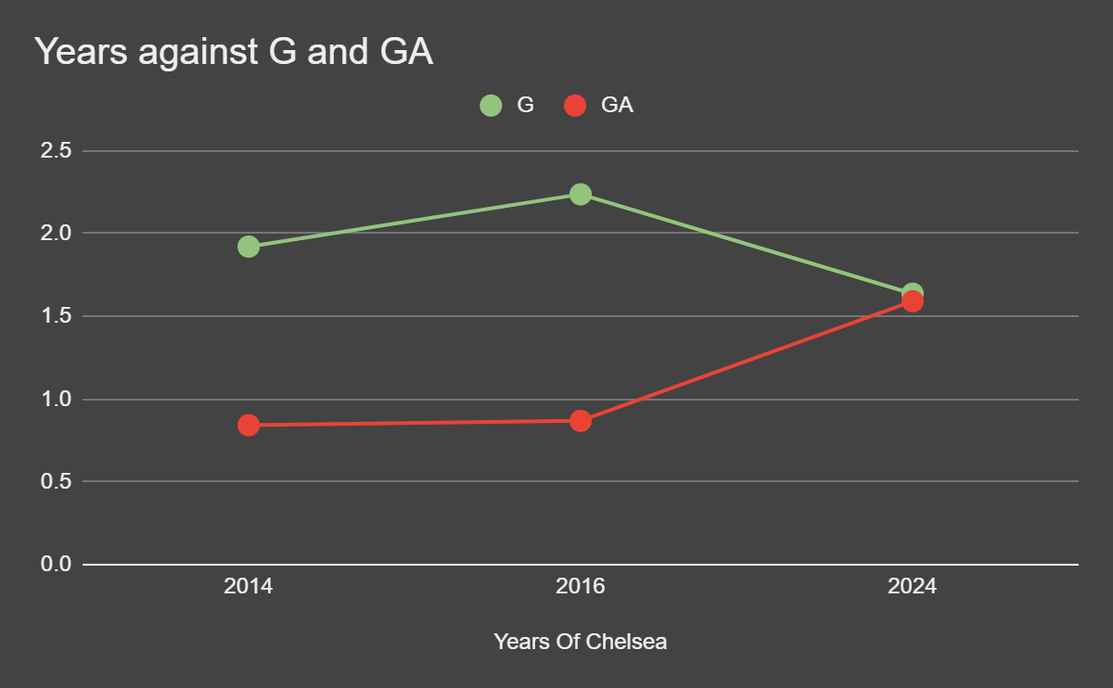
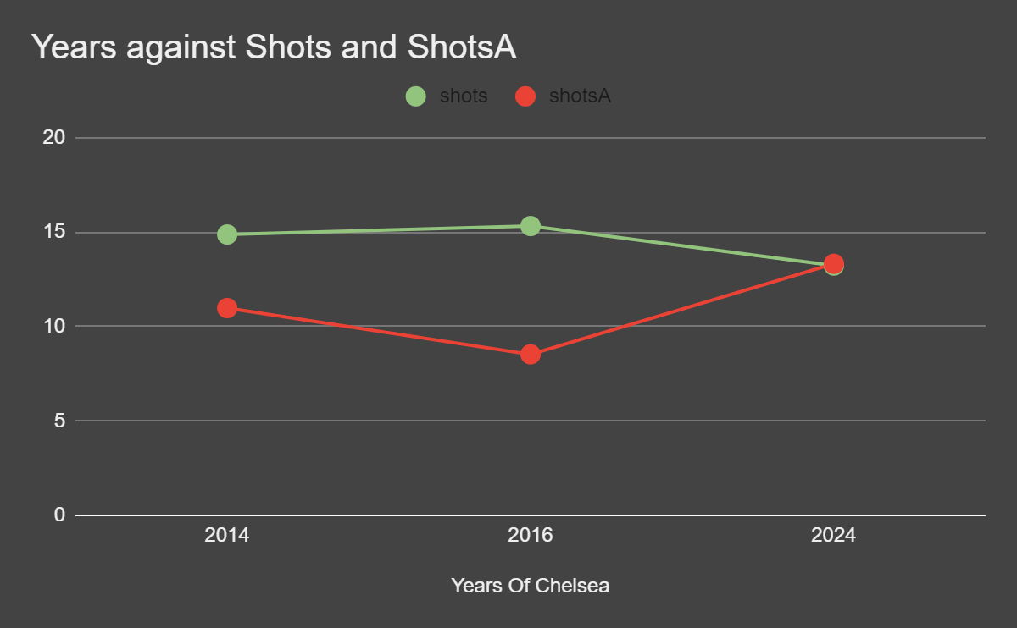
Massive dip in points. Strategy ans squad needs to be revamped
Graphs also prove the inferred points previously.

Slide 15
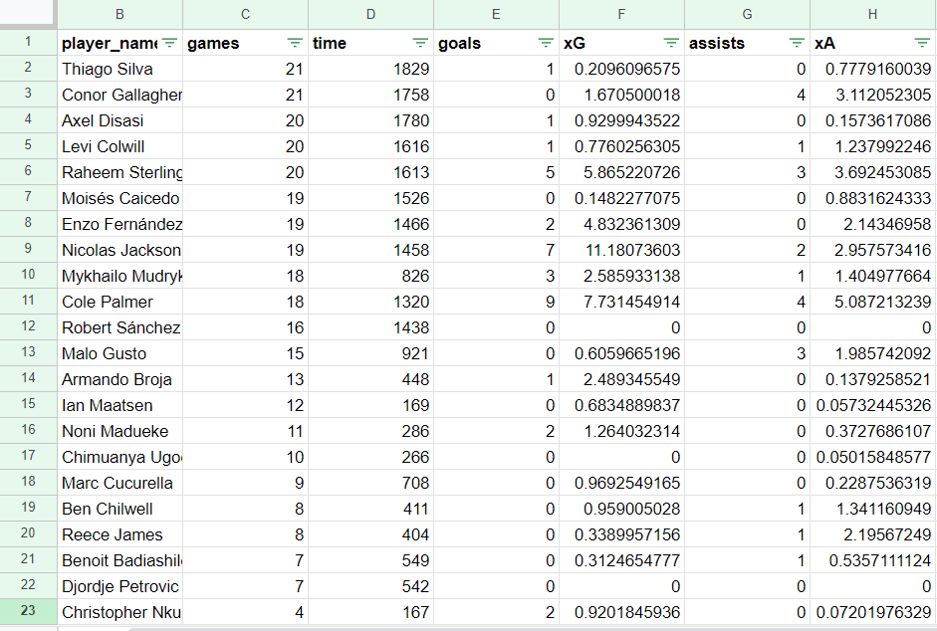

Slide 16
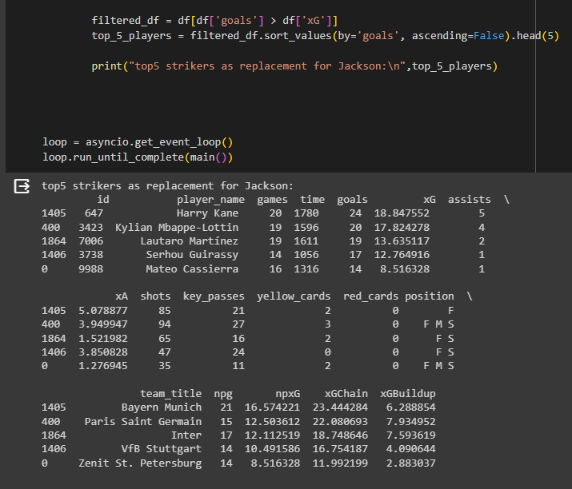
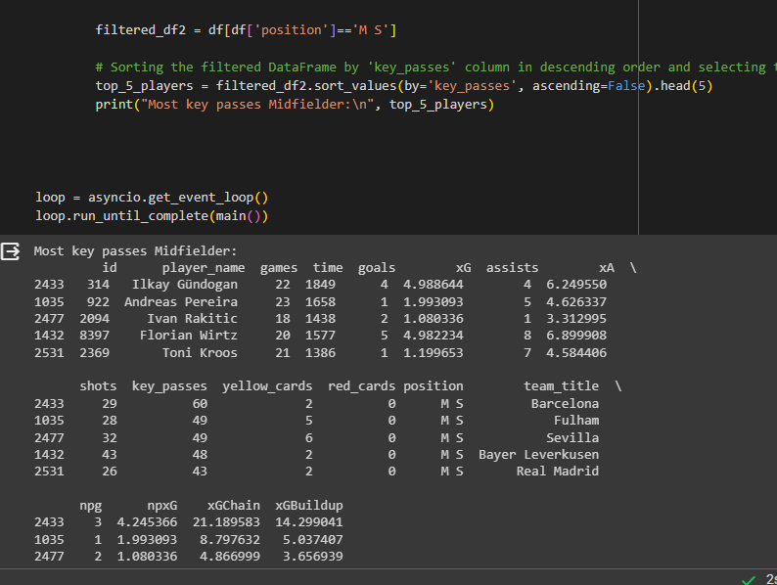
Through COLAB

Slide 17
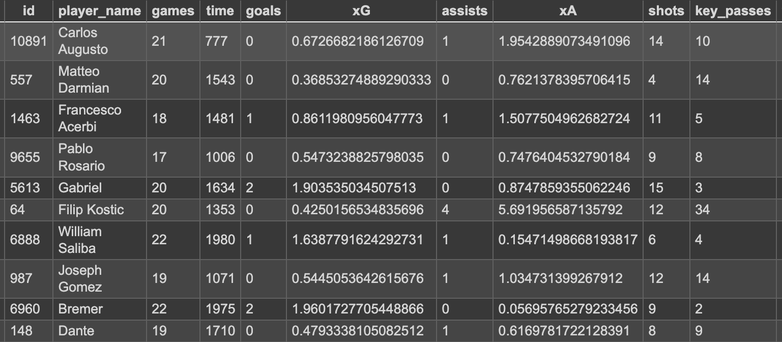
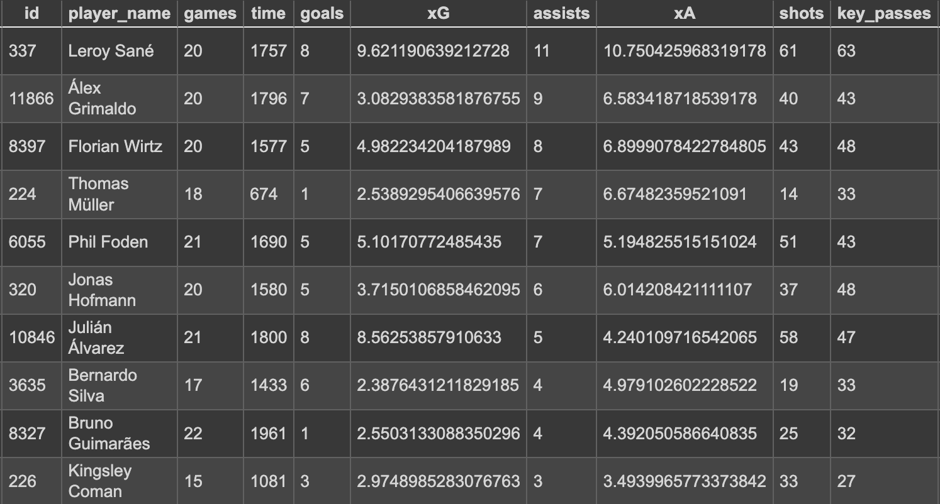
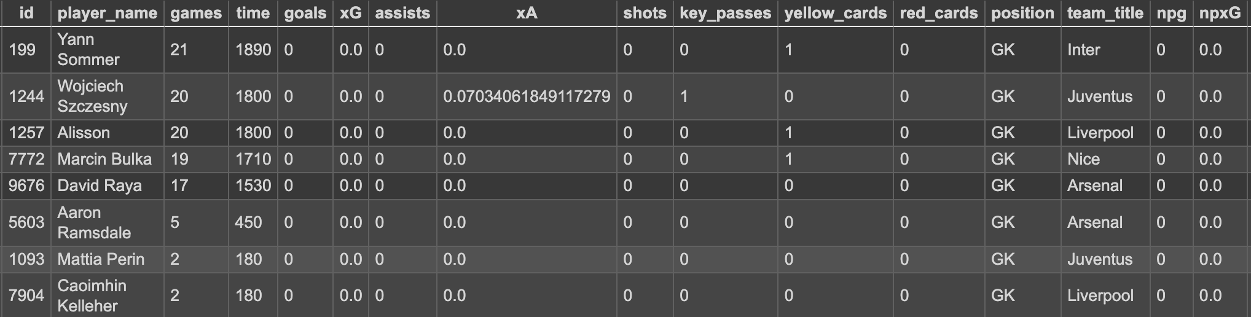
Defense
Mid Field
GK

Slide 18
STEPS followed:
DATA VISUALISATION
Introduction
Clean and Process Data
Explore the Data
Transfer Strategy
Data Visualisation
Finalise Team & Budget
Conclusion

Slide 19
STEPS followed:
FINAL TEAM
Introduction
Clean and Process Data
Explore the Data
Transfer Strategy
Data Visualisation
Finalise Team & Budget
Conclusion
$ 150 M
Current BUDGET

Slide 20
RULES TO
ADHERE TO

Slide 21

2-WAY STRATEGY
ATTACKING CHANGES
DEFENSIVE CHANGES
1D-2M-2A
1A-2M-2D

Slide 22
ATTACKING CHANGES
1D-2M-2A

Slide 23


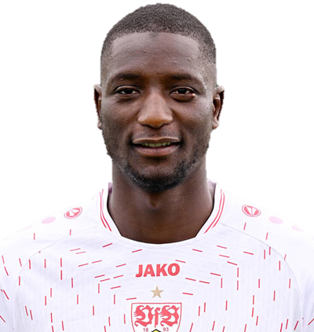
+ $ 25 M
Nicolas Jackson
Serhou Guirassy
G
7
XG
11.2
Shots
45
G
17
XG
12.8
Shots
47
-$ 40 M

Slide 24
ATTACKING CHANGES
BOUGHT
SOLD
Serhou Guirassy
William Saliba
Álex Grimaldo
Mateo Cassierra
Florian Wirtz
Nicolas Jackson
Benoit Badiashile Mukinayi
Marc Cucurella
Raheem Sterling
( MIDFIELDER)

Slide 25
DEfensive CHANGES
1A-2M-2D

Slide 26
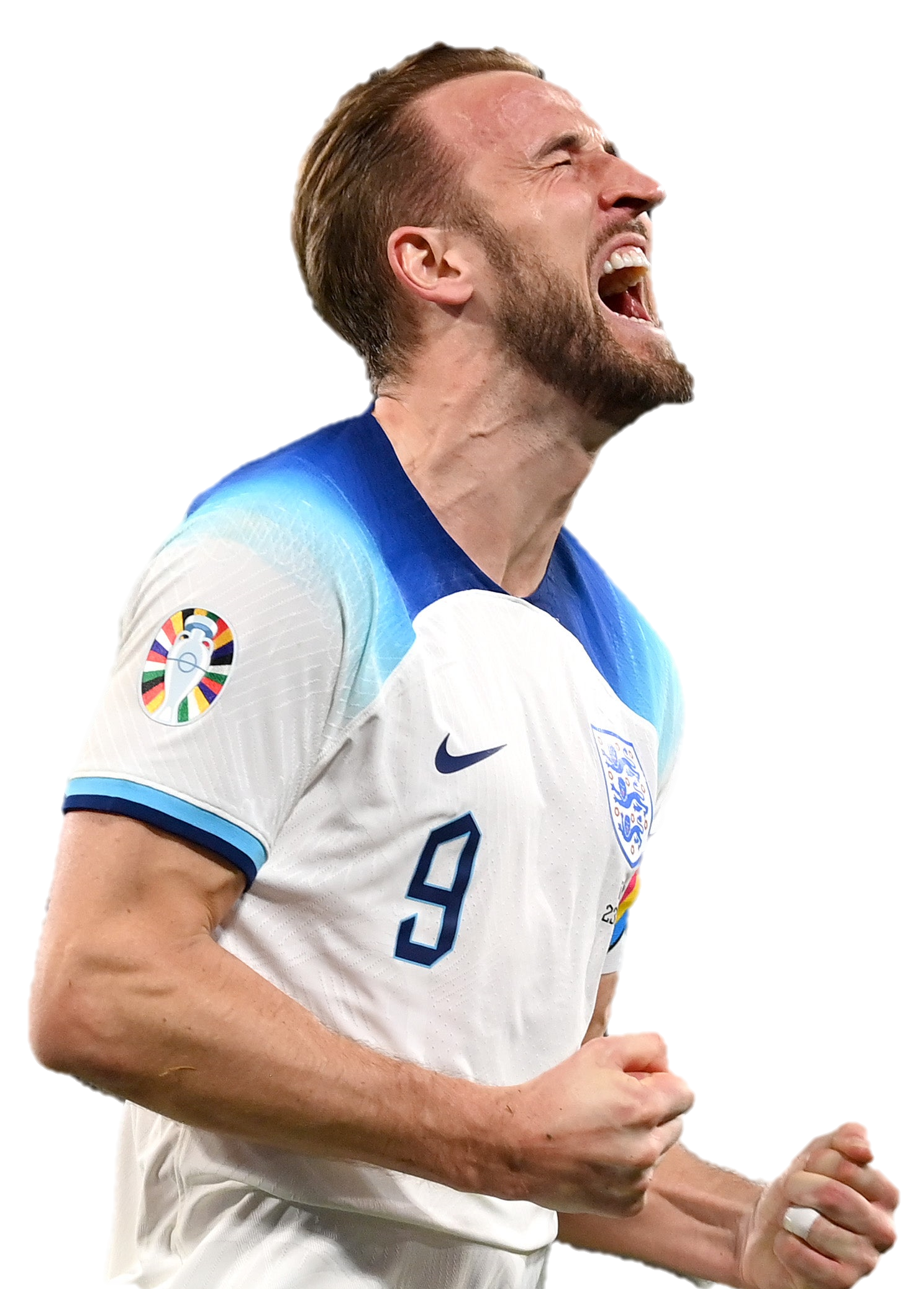
+ $ 25 M
Nicolas Jackson
Harry kane
G
7
XG
11.2
Shots
45
G
23
XG
18.0
Shots
79
-$ 110 M

Slide 27
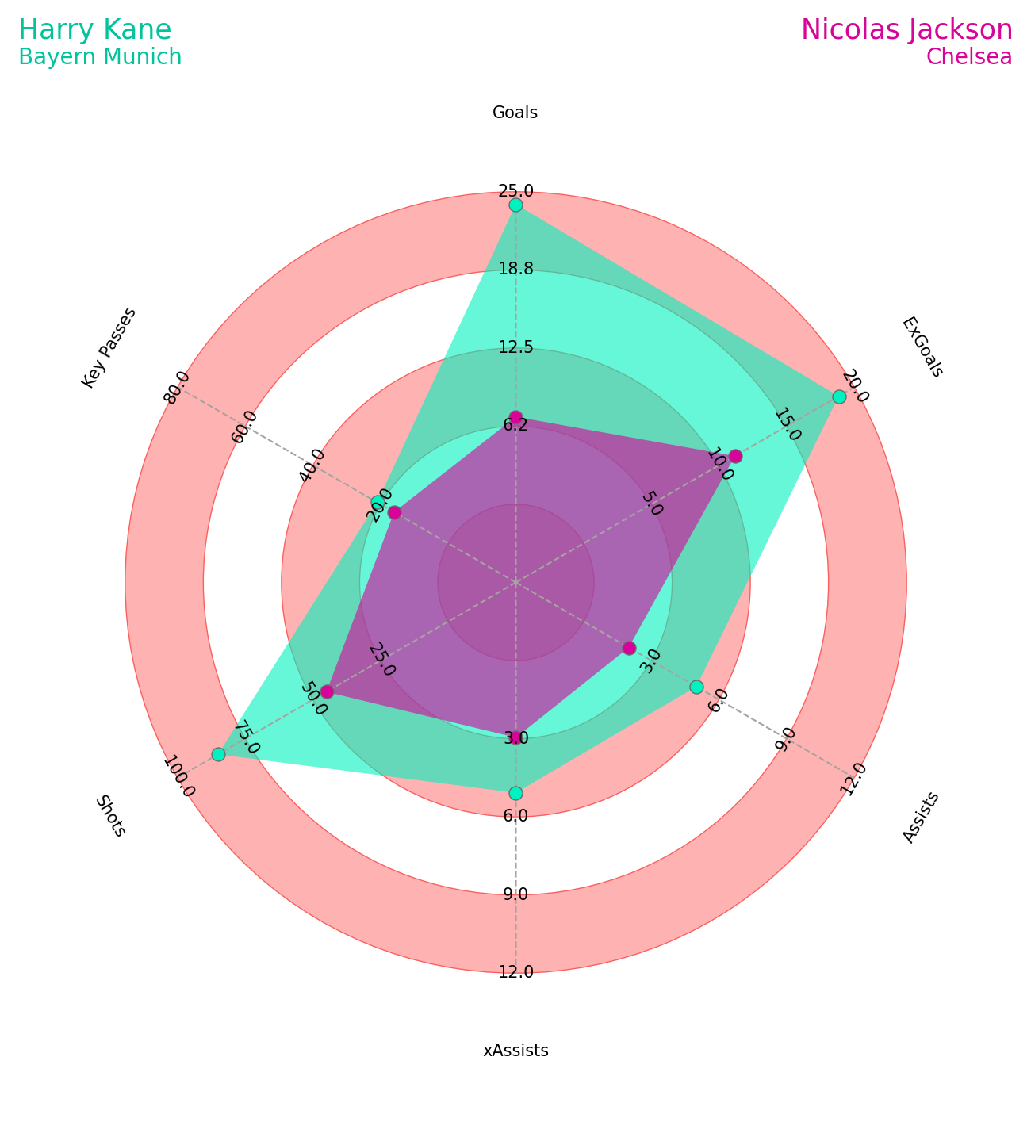
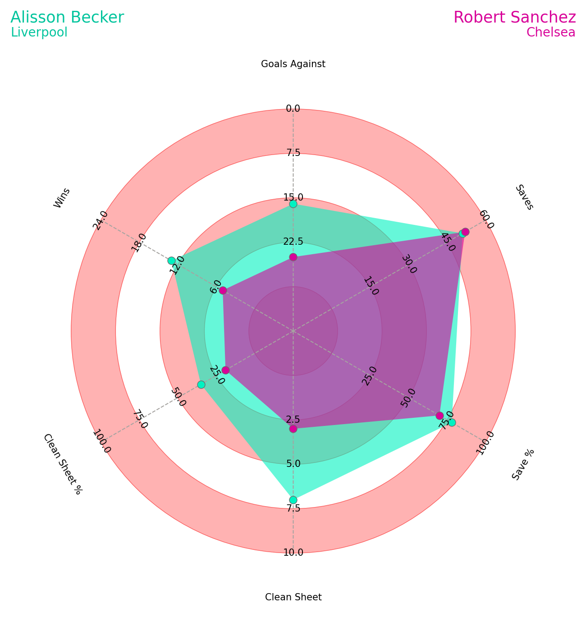

Slide 28
DEfensive CHANGES
BOUGHT
SOLD
HARRY KANE
alisson becker
JOSEPH GOMEZ
Pablo Rosario
Florian Wirtz
Nicolas Jackson
Robert Sánchez
Marc Cucurella
Raheem Sterling
( MIDFIELDER)

Slide 29
STEPS followed:
FINAL TEAM
Introduction
Clean and Process Data
Explore the Data
Transfer Strategy
Data Visualisation
Finalise Team & Budget
Conclusion
$ 150 M
Current BUDGET

Slide 30
STEPS followed:
FINAL TEAM
Introduction
Clean and Process Data
Explore the Data
Transfer Strategy
Data Visualisation
Finalise Team & Budget
Conclusion
$ 150 M
Current BUDGET

Slide 31
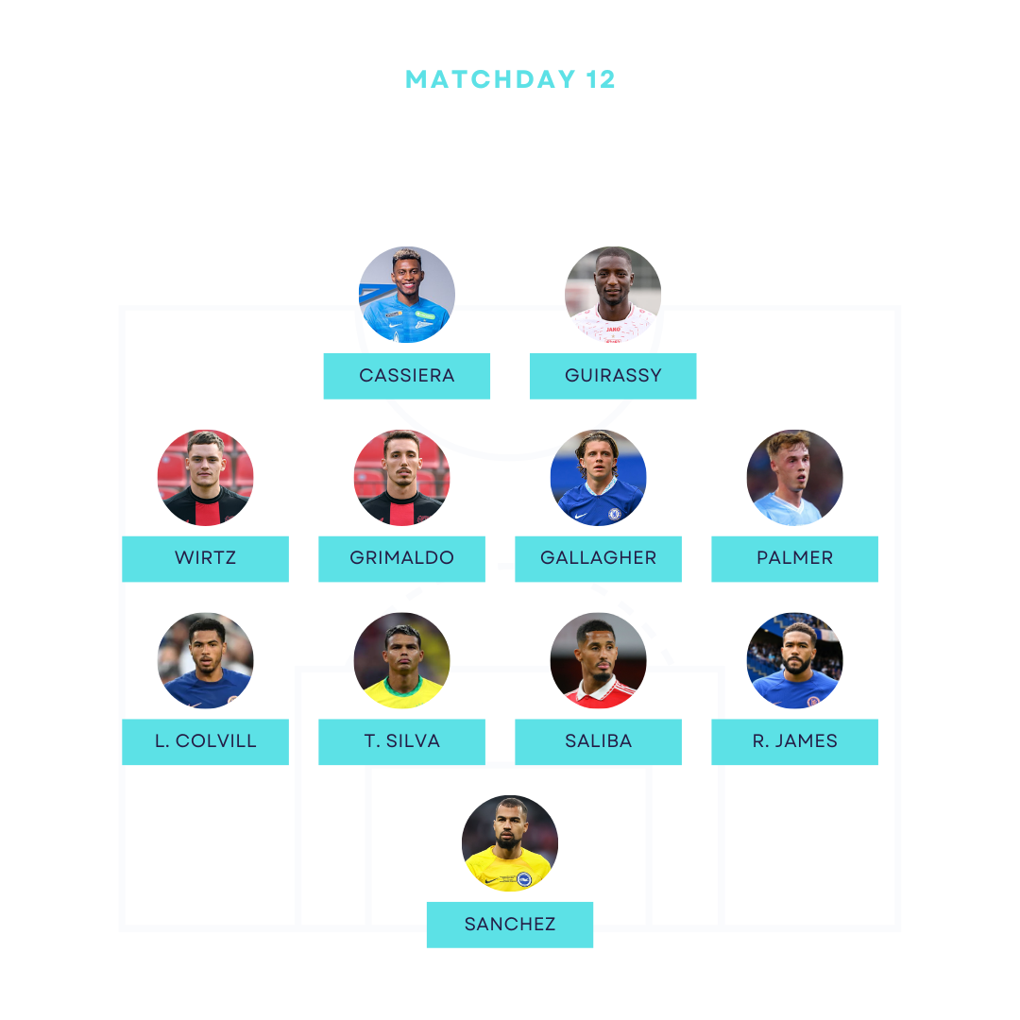
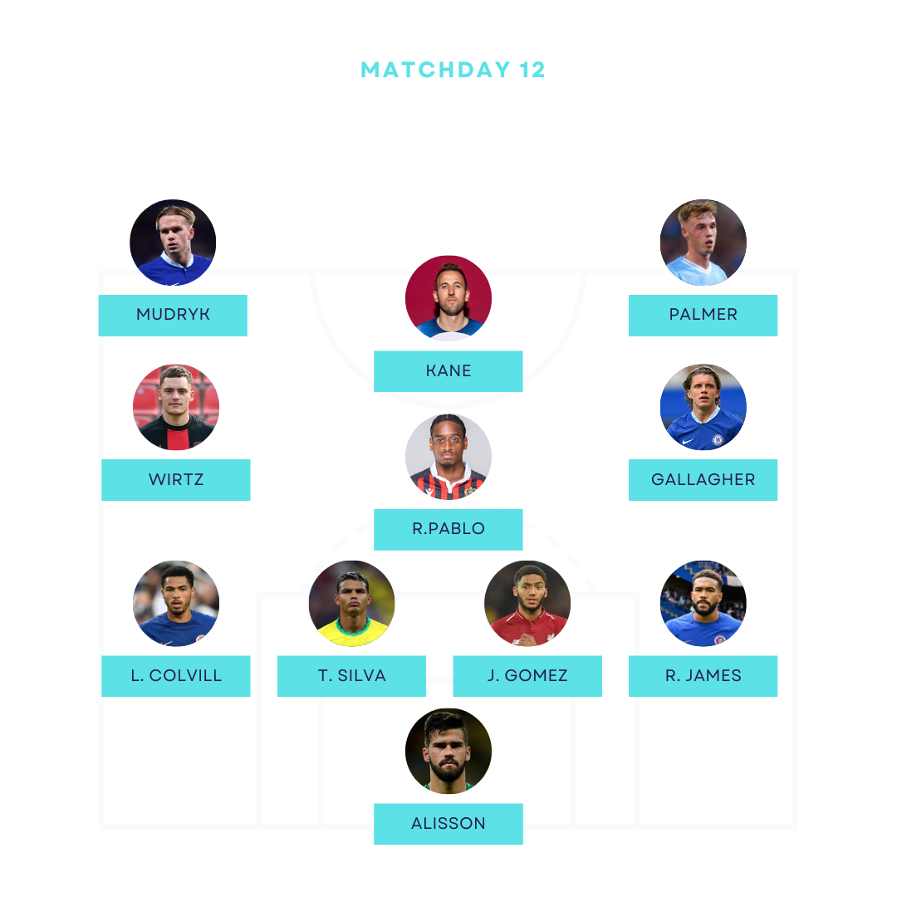

Slide 32
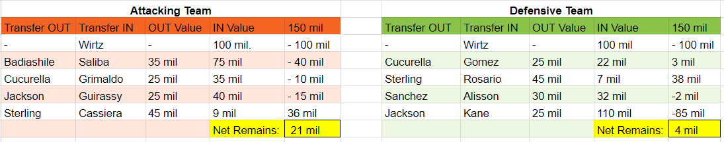
BUDGET SHEET

Slide 33


